Slide 1
PLAY STORE APP REVIEW ANALYSIS
Garima saini
Punjab Institute of Technology, Rajpura
Computer Science and Engineering

Slide 2
OUTLINE
Introduction.
Problem Statement.
Proposed System / Solution.
System Development Approach (Technology Used).
Algorithm & Deployment.
Result.
Conclusion.
Future Scope.
References.

Slide 3

INTRODUCTION
Google Play Store is engulfed with a few thousand new applications regularly with a progressively huge number of designers working freely or on the other hand in a group to make them successful, with the enormous challenge from everywhere throughout the globe. Since most Play Store applications are free, the income model is very obscure and inaccessible regarding how the in-application buys, adverts and memberships add to the achievement of an application.
Google Play was launched on March 6, 2012, bringing together the Android Market marking a shift in Google's digital distribution strategy.
Android is the dominant mobile operating system today more than 85% of all mobile devices running Google’s OS. The Google Play Store is the largest and most popular Android app store.
There are more than 3.04 million apps found on Google Play Store.
The main goal of our project is:
The purpose of our project is to gather and analyze detailed information on apps in the Google Play Store to provide insights into app features and the current state of the Android app market.
The Objective of the project is to Explore and analyse the data to discover key factors responsible for app engagement and success.

Slide 4
Problem Statement
Example: The Play Store app data has enormous potential to drive app-making businesses to success. Actionable insights can be drawn for developers to work on and capture the Android market. Each app (row) has values for category, rating, size, and more. Another dataset contains customer reviews of the Android apps. Explore and analyse the data to discover key factors responsible for app engagement and success.

Slide 5
PROPOSED SOLUTION
Play Store App Data: Retrieve the Play Store app data from sources like Google Play Store API or web scraping techniques. Store the data in a structured format like CSV or a database.
Customer Reviews Data: Obtain customer review data from sources like Google Play Store API or web scraping. Store the data alongside the app data in a structured format.
ETL Pipeline: Develop an ETL pipeline to clean and preprocess the raw data. This pipeline involves steps such as data cleaning, handling missing values, data transformation (e.g., encoding categorical variables), and feature engineering.
Automated Data Updates: Implement mechanisms to periodically update the datasets to incorporate new app data and customer reviews.
Exploratory Data Analysis (EDA): Conduct EDA using Python libraries like Pandas, Matplotlib, and Seaborn to explore the datasets, visualize distributions, and identify patterns and correlations.
Model Development: Build machine learning models using libraries like Scikit-learn or TensorFlow/Keras. Experiment with various algorithms and techniques such as regression, classification, ensemble methods, and deep learning.

Slide 6
Jupyter Notebooks: Share Jupyter Notebooks containing the analysis and modelling code along with necessary data files for reproducibility and exploration.
Web Application: Develop a web application using Flask or another web framework. The application allows users to interactively input parameters, visualize insights, and explore predictions generated by the models.
Automated Pipelines: Implement automated pipelines for data preprocessing, model training, and deployment to streamline the process and ensure consistency.
Integration with APIs: Integrate with external APIs for real-time data retrieval and updates, enabling the system to adapt to changing trends and data sources.
Scalable Infrastructure: Deploy the system on scalable infrastructure such as cloud platforms (e.g., AWS, Google Cloud, Azure) to handle varying workloads and accommodate future growth.
Performance Optimization: Optimize the system for performance by leveraging distributed computing, parallel processing, and caching mechanisms where applicable.
Monitoring Tools: Implement monitoring tools and dashboards to track system performance, data quality, and model accuracy over time.
Regular Maintenance: Schedule regular maintenance tasks for data updates, model retraining, and system upgrades to ensure continued effectiveness and reliability.

Slide 7
SYSTEM APPROACH
Define Objectives and Scope:
Clearly outline the goals of the project. Are you aiming to improve user satisfaction, identify bugs, enhance features, or something else?
Define the scope of the project, including which aspects of the app or service will be analyzed based on the reviews.
Data Collection:
Access the reviews on the Play Store through the official API or scraping techniques.
Gather relevant metadata such as review ratings, timestamps, user demographics (if available), and the text of the reviews.
Data Preprocessing:
Clean the data to remove noise, such as irrelevant characters, emojis, or non-English reviews (if your analysis is limited to a specific language).
Tokenize the text, convert it to lowercase, remove stop words, and perform stemming or lemmatization to standardize the text.
Sentiment Analysis:
Apply sentiment analysis techniques to classify reviews as positive, negative, or neutral based on the sentiment expressed in the text.
Use pre-trained models or train your classifier using labelled data if necessary.

Slide 8
Identify Trends and Insights:
Analyze patterns and trends in the data. Look for recurring issues, common praise, or specific feature requests.
Quantify the frequency of different sentiments and topics to prioritise areas for improvement.
Feedback Integration:
Integrate the insights gained from the analysis into the app development or improvement process.
Prioritize and categorise feedback based on severity, impact, and feasibility of implementation.
Continuous Monitoring and Iteration:
Set up automated systems to regularly collect and analyse new reviews as they come in.
Continuously iterate on the app or service based on ongoing feedback to maintain and improve user satisfaction.
Evaluation:
Regularly evaluate the effectiveness of the changes made based on the feedback analysis.
Measure metrics such as user retention, app ratings, and user engagement to assess the impact of improvements.

Slide 9
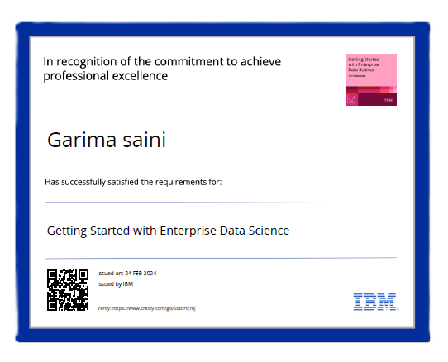
TECHNOLOGY USED
Exploratory Data Analysis (EDA) techniques: Statistical methods and visualization tools to understand data distributions, correlations, and patterns.
Machine Learning:
Scikit-learn: Python library for machine learning tasks such as classification, regression, and clustering.
TensorFlow: Deep learning frameworks for building and training custom machine learning models.
Ensemble learning techniques: Methods like Random Forests or Gradient Boosting for predictive modelling.
Deployment and Visualization:
Jupyter Notebooks: Interactive computing environment for data analysis and visualization.
Flask or Django: Python web frameworks for building interactive dashboards or web applications.
Heroku or AWS: Platforms for deploying and hosting web applications.
Data Collection and Preprocessing:
Python: A versatile programming language for data manipulation and analysis.
Pandas: Python library for data manipulation and analysis, useful for handling structured data.
NumPy: Python library for numerical computations, often used in conjunction with Pandas.
Google Play Store API: For programmatically accessing Play Store app data.
Data Analysis and Visualization:
Matplotlib and Seaborn: Python libraries for creating static visualizations.
Plotly: Python library for creating interactive and dynamic visualizations.

Slide 10
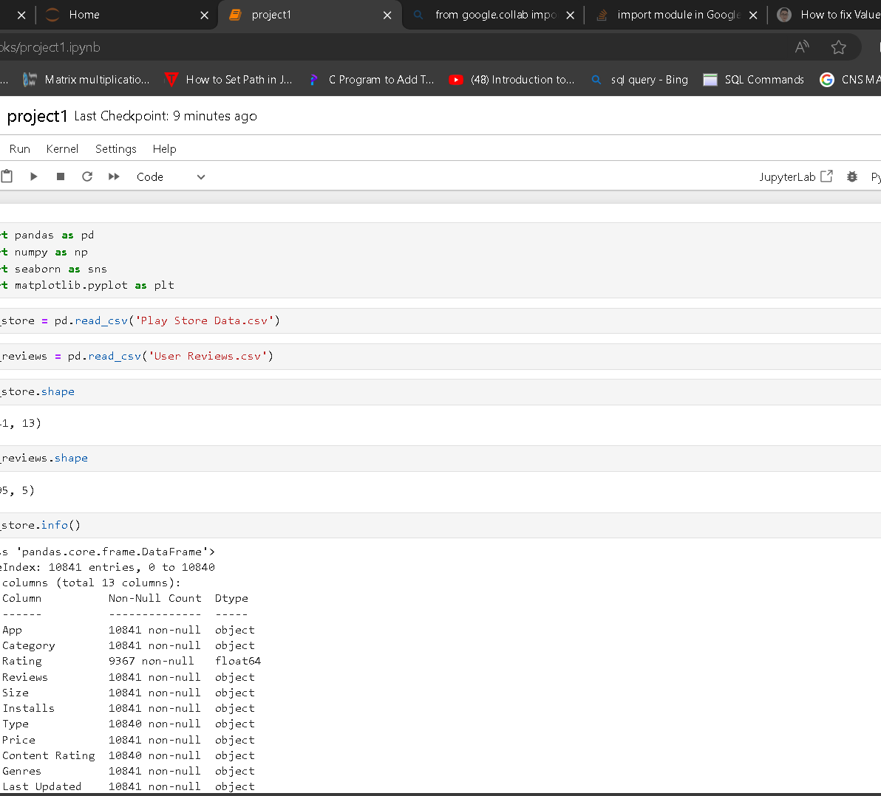
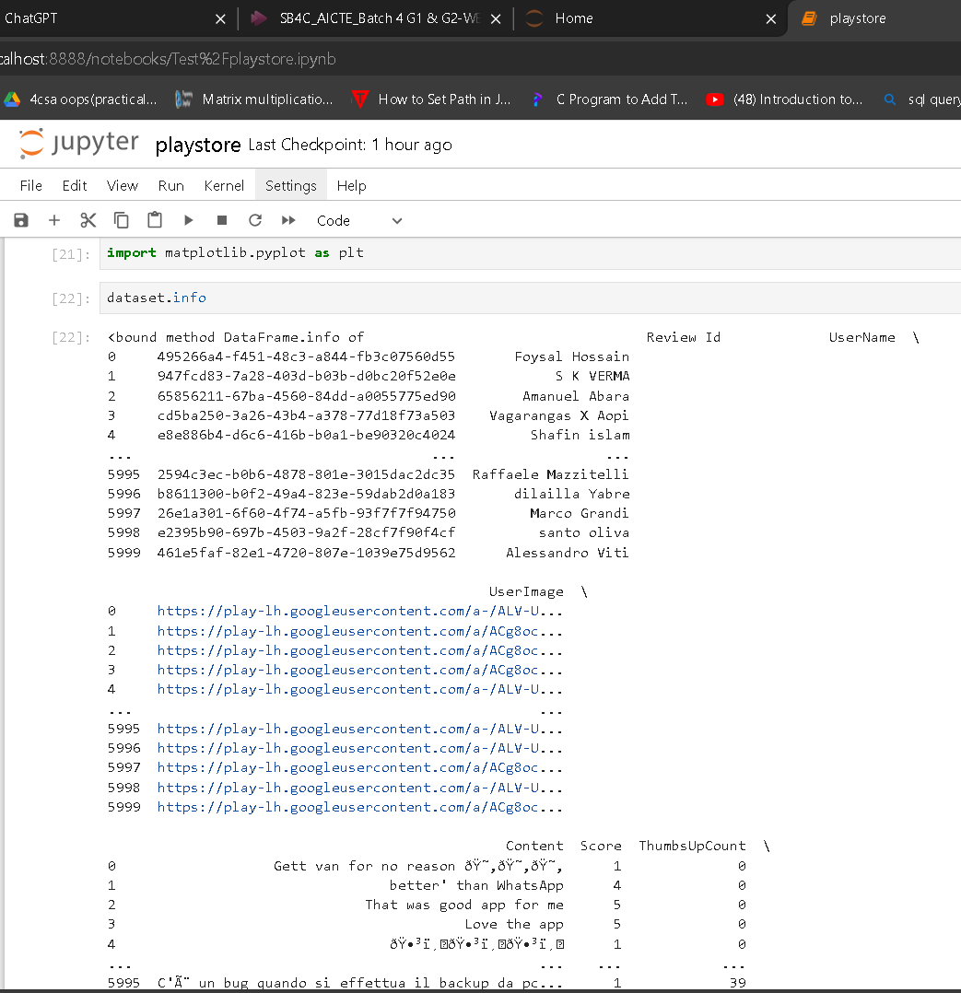
CODE
CODE

Slide 11
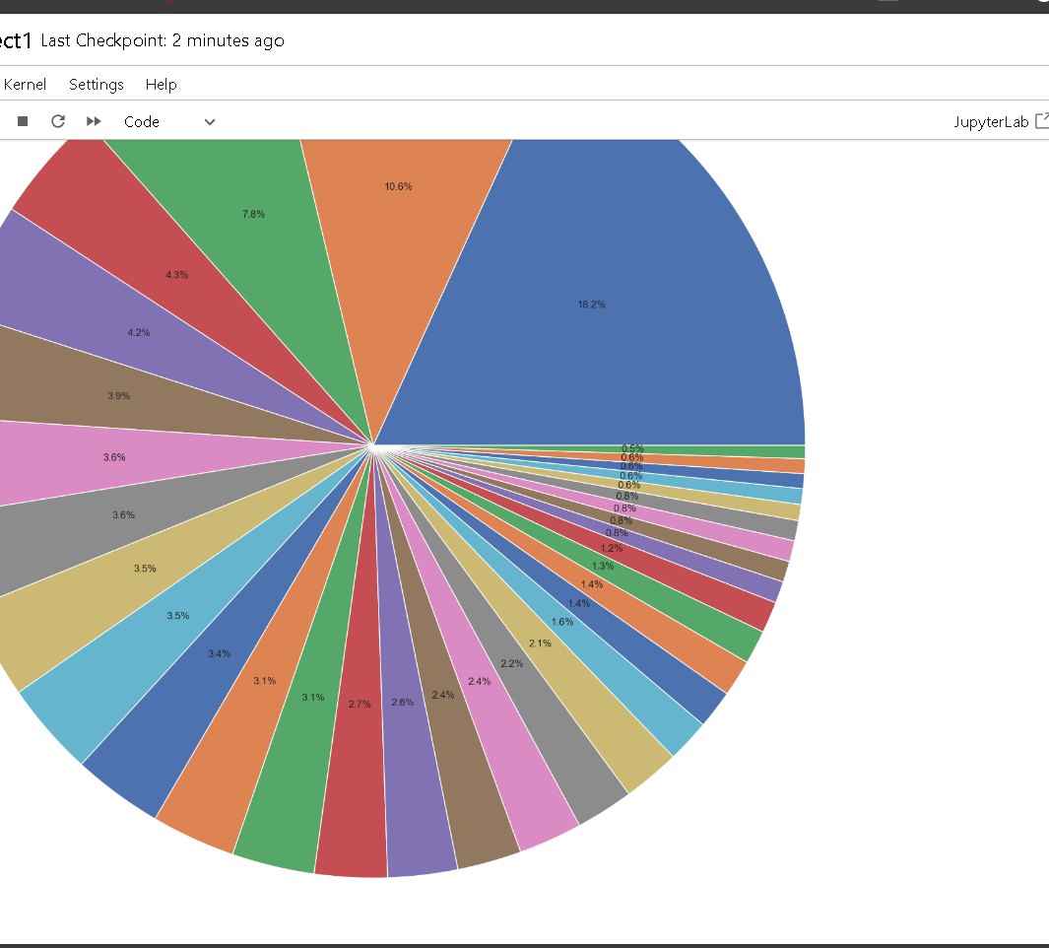
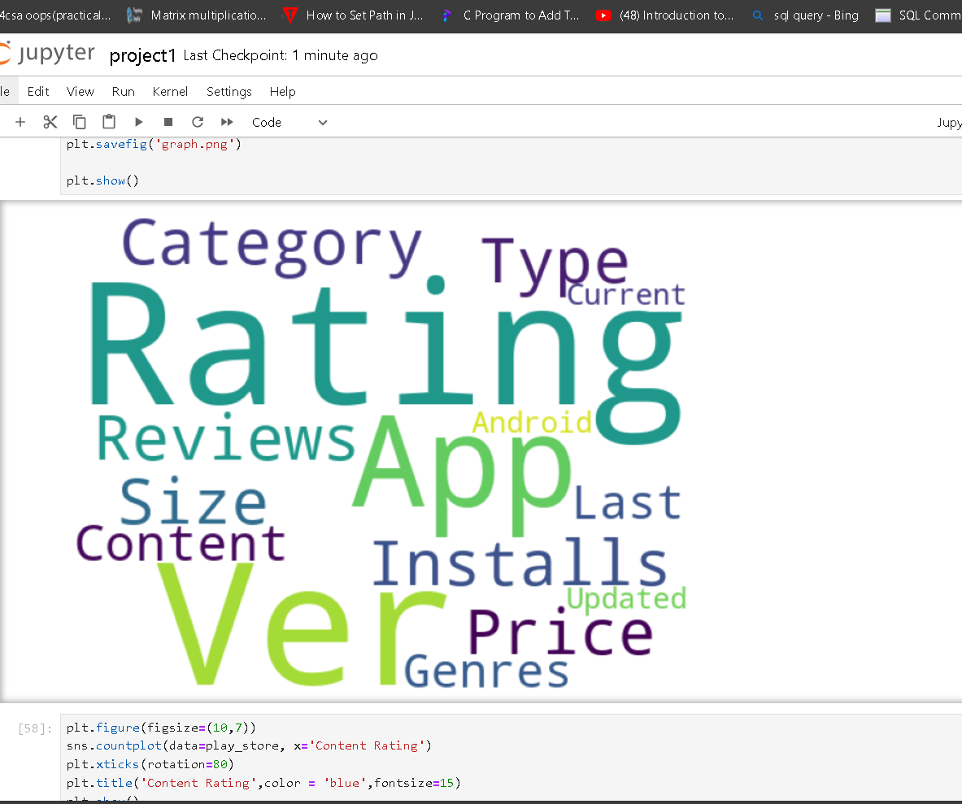
CODE
CODE

Slide 12
ALGORITHM AND DEPLOYMENT
Data Collection: The first step is to gather the data required for analysis. In this case, we need data related to Play Store apps, including their reviews and ratings. Google Play Store does not provide a direct way to access this data, but there are third-party tools and APIs available that can help you collect this data.
Data Preprocessing: Once you have collected the data, you need to preprocess it to make it suitable for analysis. This involves cleaning the data, removing any irrelevant information, and transforming it into a format that can be easily analyzed.
Exploratory Data Analysis (EDA): This step involves analyzing the data to identify trends, patterns, and insights. You can use various data analysis techniques, such as statistical analysis, data visualization, and machine learning algorithms, to gain insights from the data.
Text Analysis: As the data includes app reviews, which are unstructured text data, you need to perform text analysis to extract meaningful insights from the data. This involves techniques such as natural language processing (NLP) and sentiment analysis.
Utilize Machine Learning: algorithms like linear regression, decision trees, or random forests to predict app success based on factors like category, ratings, and size.
Deployment: Finally, you can deploy the analysis system on a web server or mobile app to make it accessible to users. You can use tools such as Flask or Django for web deployment, or React Native or Xamarin for mobile app deployment.

Slide 13
CONCLUSION
RESULT
Improved User Satisfaction: By addressing recurring issues and implementing user-requested features, user satisfaction is likely to increase, leading to higher retention rates and positive word-of-mouth promotion.
Enhanced App Ratings: Positive changes based on feedback analysis can result in higher average ratings on the Play Store, which in turn can attract more users and improve the app's visibility in search results.
Increased User Engagement: By incorporating features and improvements aligned with user preferences, users are more likely to engage with the app regularly, leading to increased session durations and overall usage.
Feature Prioritization: Insights gained from review analysis help prioritize feature development efforts, ensuring that resources are allocated to areas with the greatest impact on user satisfaction and retention.
Continuous Improvement Culture: Implementing a systematic approach to review analysis fosters a culture of continuous improvement within the organization, where feedback is valued and used to drive iterative development cycles.
The analysis provides valuable insights for app developers to optimize their app features and strategies to increase engagement and success in the Android market.
Understanding user preferences and behaviour can significantly impact app development and marketing strategies.
User feedback analysis into the development lifecycle, organizations can foster greater user satisfaction, improve app ratings, and drive long-term success in the competitive landscape of app markets like the Play Store.
Its systematic approach serves as a cornerstone for data-driven decision-making, enabling organizations to deliver high-quality experiences that resonate with their user base.

Slide 14
REFERENCES
FUTURE SCOPE
Implement natural language processing (NLP) techniques to analyze customer reviews more effectively.
Explore advanced machine learning models like neural networks for better predictions.
Continuously update the model with new data to adapt to changing market trends.
Incorporating sentiment analysis on customer reviews to understand user satisfaction and preferences more deeply.
Implementing recommendation systems to suggest features or categories based on user preferences.
Continuously updating the analysis with new data to adapt to changing trends and preferences in the Android market.
GeeksforGeeks
Analytics Vidhya
Stackoverflow
Towards data science
Python libraries documentation
Data camp
1. Researchgate.net
2. https://www.academia.edu

Slide 15
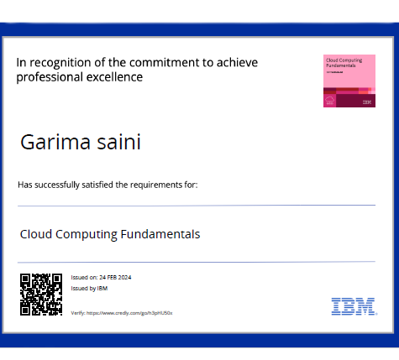
CERTIFICATE 1
CERTIFICATE 2

Slide 16
THANK YOU
.

